Slide 1
Kaya Uke
My project? Flexible, Biocompatible, and Wirelessly Powered Implantable Optoelectronics | What I did last four weeks? Learning CAD/FEA Design Prototypes Integrate Circuit Design Integrate Antenna Design Mechanical Simulations
Problem being faced? CAD drawing / design Solidworks Mechanical Study Protocol Antenna | What to do in next two weeks? Simulation(COMSOL) Mechanical Actual Mechanical Testing?

Slide 2
Antenna
No tuning protocol
VNA
Commercial

Slide 3
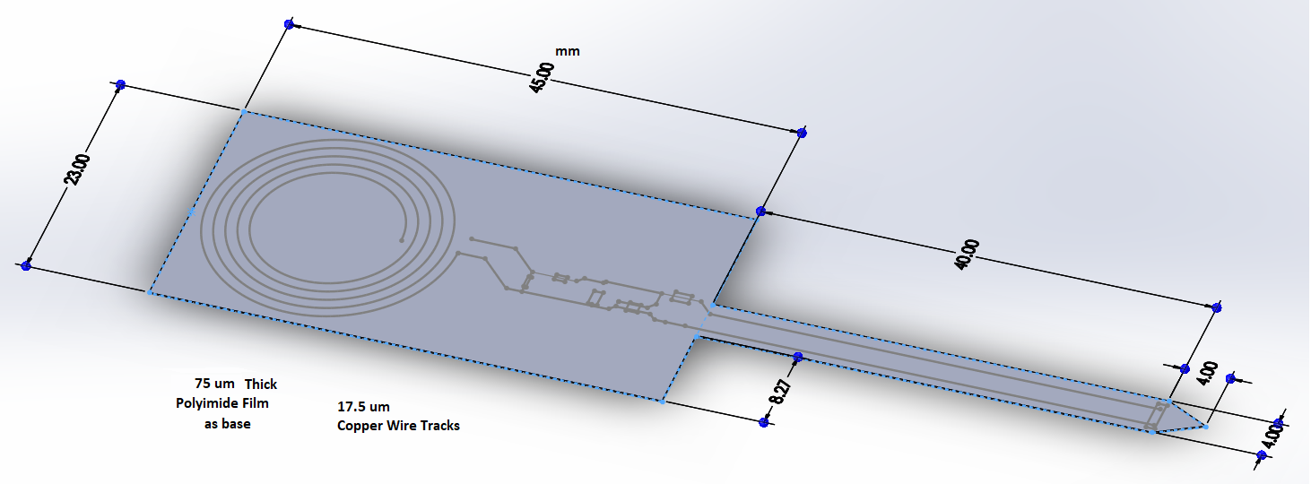
Design
Initial aim: Model the fabricated probe
Different base geometries to test

Slide 4
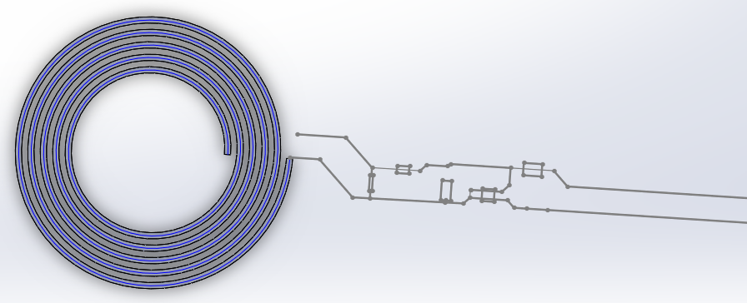
Antenna & Circuit
Circuit design is integrated
Various iterations
Further work on 3D’ing the circuit
Design suggestions for representing circuit elements?
(For mechanical / electrical / thermal simulation in COMSOL?)

Slide 5
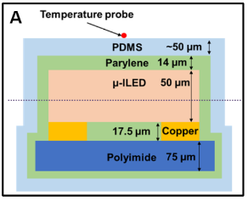
Cross Section
Material Assignment
How to represent Circuit Elements?
Source: John Rogers et al, Fully Implantable Optoelectronics Systems for Battery Free Multimodal operation in neuroscience research

Slide 6
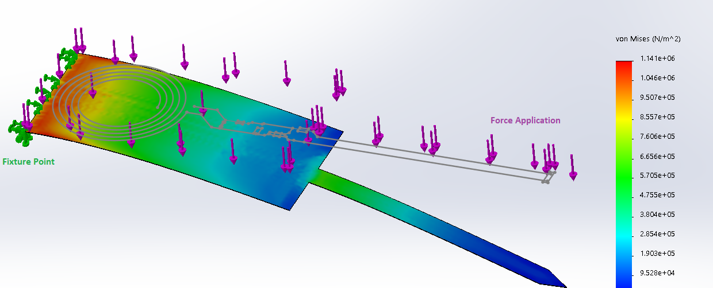
Mechanical Test
Try out different Fixture / Force Application conformations
Any practical suggestions?
Compression, Bending, Buckling, Twist
After protocol Established, move on to circuit and antenna
Test different designs, find optimal

Slide 7
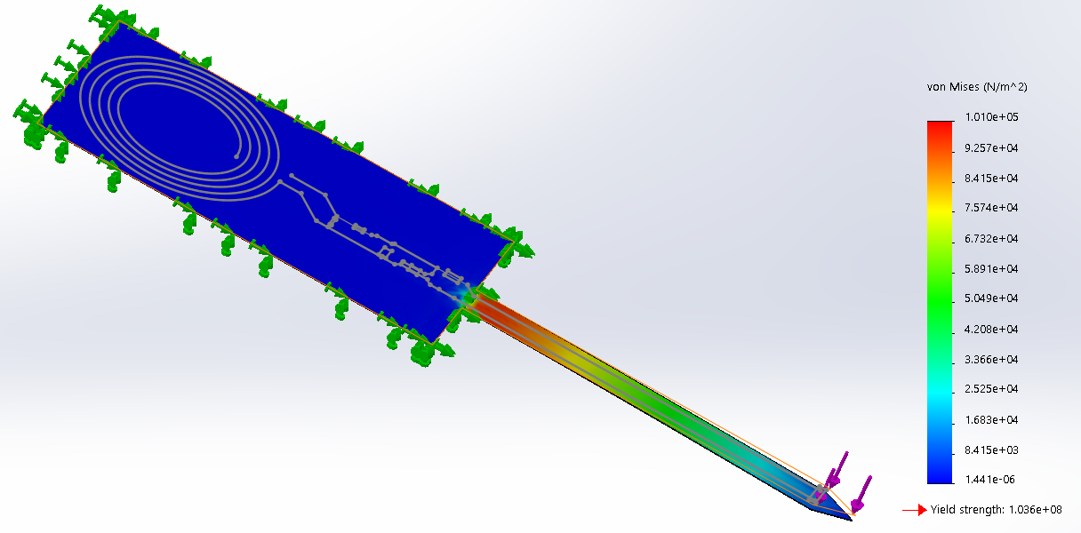
Mechanical Test
Try out different Fixture / Force Application conformations
Whole Base Fixed, Force Only applied on Shank end
Problem: Solidworks can’t simulate this case well
(Error of Large Displacement, Possible Break of Shank = simulation error?)
Solidworks not optimal for Flexible, Thin Material?

Slide 8
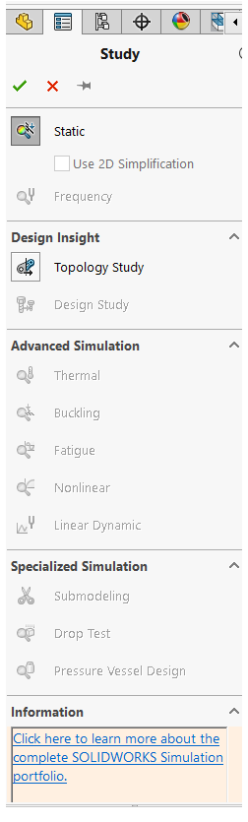
Switch to COMSOL
Solidworks is limited in FEA
(student mode / premium License)
Buckling
Thermal
Nonlinear
Linear Dynamic

Slide 9
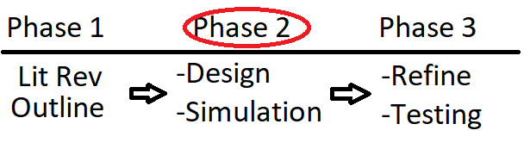
Process

Slide 10
Tasks/Questions
FEA testing with COMSOL
Protocol for mechanical simulation
For flexible, very thin material
Antenna integration and Tests of final probe.

Slide 11
References
Gutruf, P., Krishnamurthi, V., Vázquez-Guardado, A., Xie, Z., Banks, A., Su, C., Xu, Y., Haney, C., Waters, E., Kandela, I., Krishnan, S., Ray, T., Leshock, J., Huang, Y., Chanda, D. and Rogers, J. (2018). Fully implantable optoelectronic systems for battery-free, multimodal operation in neuroscience research. Nature Electronics, 1(12), pp.652-660.

